Slide 1
M3-MIFARE DESFire Training
MIFARE DESFire EV1 Architecture
Abu Ismail, BUID CAS
MIFARE DESFire EV1
Standard Product Training
2013

Slide 2
Content
MIFARE DESFire EV1 blocks
MIFARE DESFire EV1 memory
MIFARE DESFire EV1 application
MIFARE DESFire EV1 files
MIFARE DESFire EV1 file access rights
MIFARE DESFire EV1 RF communication
MIFARE DESFire EV1 back-up management
MIFARE DESFire EV1 application example
M305_MIFARE DESFire Training - MIFARE DESFire EV1 Architecture _AIv13.01.ppt

Slide 3
MIFARE DESFire EV1 hardware blocks
MIFARE DESFire EV1
LA
RF
UART
TRUE RANDOM
INTERFACE
DES CO-
PROCESSOR
ISO 14443A
AES CO-
PROCESSOR
NUMBER
CARD
SECURITY
GENERATOR
COIL
LB
SENSORS
POWER ON
RESET
CONSTANT
POWER
CPU / Logic Unit
CRC 16
CRC 32
VOLTAGE
REGULATOR
CLOCK
INPUT FILTER
ROM
RAM
EEPROM
RESET
RAM
GENERATOR
M305_MIFARE DESFire Training - MIFARE DESFire EV1 Architecture _AIv13.01.ppt

Slide 4
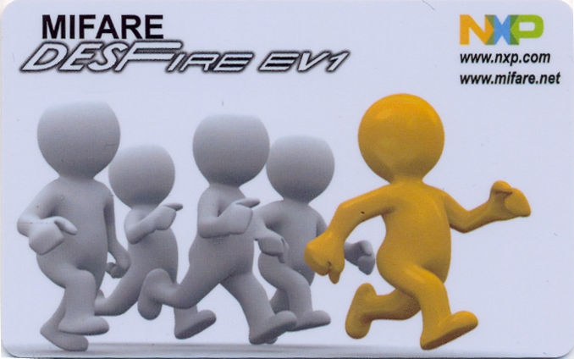

MIFARE DESFire EV1 memory
Secure Memory
MIFARE DESFire EV1 8KB: 8192 bytes
MIFARE DESFire EV1 4KB: 5088 bytes
MIFARE DESFire EV1 2KB: 2528 bytes
M305_MIFARE DESFire Training - MIFARE DESFire EV1 Architecture _AIv13.01.ppt

Slide 5



MIFARE DESFire EV1 card level
Delete needs always authentication
Deleting application is also possible with the application master key (AMK)
-- Comfortable for multi-application
Application
Application
Application
Up to 28
application
1 Card Master Key
(CMK)
Card (Master Key) Setting
Application
Application
Application
Nr of byte
Create application command
Change-key key nr. (b7- b4) Allow changing this setting (b3) Allow create & delete file w/o AMK (b2) Allow list of the files w/o AMK (b1) Allow change AMK (b0)
Crypto option (b7-b6) Use ISO7816 file ID (b5) RFU (b4) Nr. of keys (b3-b0)
See doc nr. 0945xx for memory usages
M305_MIFARE DESFire Training - MIFARE DESFire EV1 Architecture _AIv13.01.ppt

Slide 6

MIFARE DESFire EV1 application level
Five Types of file are supported:
Standard data file
Back-up data file
Value file
Cyclic record file
Linear record file
Key 0 Key 1
…..
Key n
Free
Never
APK
Up to
14 keys
Up to
32 files
Settings
All files except standard data file has anti-tearing mechanism.
APK : Application Key
AMK: Application Master key, can be used as APK as well.
M305_MIFARE DESFire Training - MIFARE DESFire EV1 Architecture _AIv13.01.ppt

Slide 7
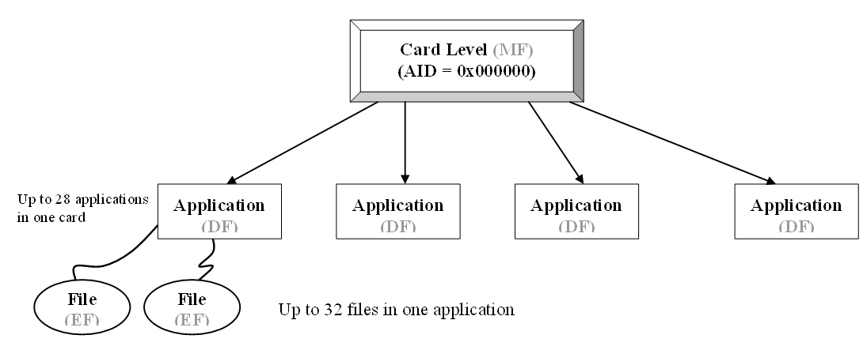
MIFARE DESFire EV1 file structure
Flexible file structure
MF = “3F00”
Maximum
28 Applications
AID any three bytes, except 0x000000
Maximum
32 files
MIFARE DESFire EV1 supports ISO/IEC 7816 type file structure.
M305_MIFARE DESFire Training - MIFARE DESFire EV1 Architecture _AIv13.01.ppt

Slide 8

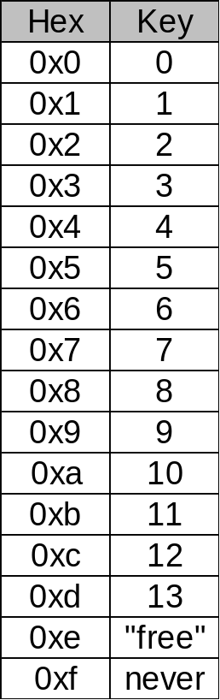
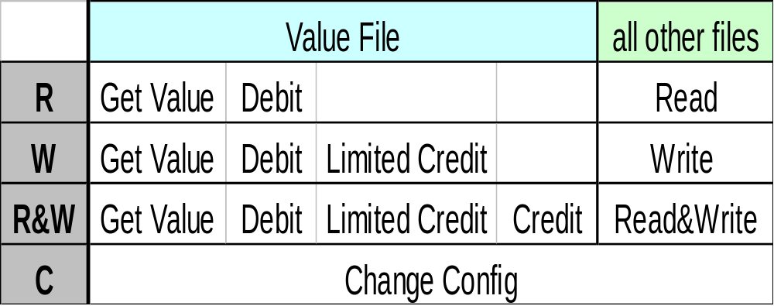
MIFARE DESFire EV1 coding of access rights
During creation of a file the access rights are defined with a 2-byte code:
MSBit
LSBit
4 different access rights are offered for each file.
For every two files one block of memory is used for storing attributes.
no authentication required
no access allowed
M305_MIFARE DESFire Training - MIFARE DESFire EV1 Architecture _AIv13.01.ppt

Slide 9
MIFARE DESFire EV1 standard data file
Standard data file (0x00)
File Id:0x00 .. 0x1F
Standard data file is usually used for storing static data (e.g. name, contract which are not modified on the fly).
Nr. of byte
Create std. data file command
1
1
2
1
2
3
CMD
File Id
ISO 7816 *
file Id (optional)
Com set
Access rights
File size
LSB first,
in selection
MSB first
Plain,
(C)MACed,
Encrypted
LSB first
BCRW**
LSB first
* Must be activated in the application to use, if activated at application must be used for files.
** B = Both read and write
M305_MIFARE DESFire Training - MIFARE DESFire EV1 Architecture _AIv13.01.ppt

Slide 10
MIFARE DESFire EV1 back-up data file
Back-up data file (0x01)
File Id: 0x00 .. 0x1F
Back-up data file is usually used for storing dynamic data (which needs to modify on the fly). Takes longer times for first-write within the transaction.
Nr. of byte
Create back-up data file command
1
1
2
1
2
3
CMD
File Id
ISO 7816 *
file Id (optional)
Com set
Access rights
File size
LSB first,
in selection
MSB first
Plain,
(C)MACed,
Encrypted
LSB first
BCRW**
LSB first
* Must be activated in the application to use, if activated at application must be used for files.
** B = Both read and write
M305_MIFARE DESFire Training - MIFARE DESFire EV1 Architecture _AIv13.01.ppt

Slide 11
MIFARE DESFire EV1 Backup management for back-up data file
Backup data file
Valid image
Image 1
Write
updates mirror image
Image 2
Image 2
Write Data
Commit Transaction validates updated image
Image 1
Valid image
Image 2
*Data File backup management requires a backup data file.
M305_MIFARE DESFire Training - MIFARE DESFire EV1 Architecture _AIv13.01.ppt

Slide 12
MIFARE DESFire EV1 value file
Value file (0x02)
File Id:0x00 .. 0x1F
Required EEPROM size: = 32 Bytes
Value range = -2147483648...+2147483647
(4-byte signed integer)
Lower limit = -2147483648...+2147483647
Upper limit = -2147483648...+2147483647
(Lower limit ≤ Upper limit)
1
1
1
Nr. of byte
2
4
4
4
1
Create value file command
CMD
File Id
Com set
Access rights
Lower limit
Upper limit
Value
Lt. credit, Free get value
Plain
(C)MACed
Encrypted
LSB first
BCRW*
LSB
first
b7- b2 b1 b0
x Lt credit (1 enable, 0 disable)
x Free get value ( 1 enable, 0 disable)
ISO 7816 does not support value file, so no ISO file ID
* R = Get Value +Debit, W = GetValue +Debit + Limited credit, B = GetValue + Debit + Limited credit + Credit
M305_MIFARE DESFire Training - MIFARE DESFire EV1 Architecture _AIv13.01.ppt

Slide 13
MIFARE DESFire EV1 backup management for value file
Value file
Valid image
Write
updates mirror image
Image 1
Image 2
Image 2
Image 2
Image 1
Image 2
Write
Commit Transaction validates updated image
Valid image
Image 1
Image 2
Image 1
Image 2
M305_MIFARE DESFire Training - MIFARE DESFire EV1 Architecture _AIv13.01.ppt

Slide 14
MIFARE DESFire EV1 linear record file
Linear record file (0x03)
File Id:0x00 .. 0x1F
Usually used for log, record of the transaction.
Create linear record file command
1
1
2
1
2
3
3
CMD
File Id
ISO 7816* file Id
Com set
Access rights
Record size
Max. nr. of records
LSB first,
in selection
MSB first
LSB first
BCRW**
LSB
first
LSB
first
* Must be activated in the application to use, if activated at application must be used for files.
** B = Both read and write
M305_MIFARE DESFire Training - MIFARE DESFire EV1 Architecture _AIv13.01.ppt

Slide 15
MIFARE DESFire EV1 cyclic record file
Cyclic record file (0x04)
File Id:0x00 .. 0x1F
Usually used for log, record of the transaction.
Create cyclic record file command
1
1
2
1
2
3
3
CMD
File Id
ISO 7816* file Id
Com set
Access rights
Record size
Max. nr. of record
LSB first,
in selection
MSB first
LSB first
BCRW**
LSB
first
LSB
first
Cyclic record file stores latest max. nr. of record -1
* Must be activated in the application to use, if activated at application must be used for files.
** B = Both read and write
M305_MIFARE DESFire Training - MIFARE DESFire EV1 Architecture _AIv13.01.ppt

Slide 16
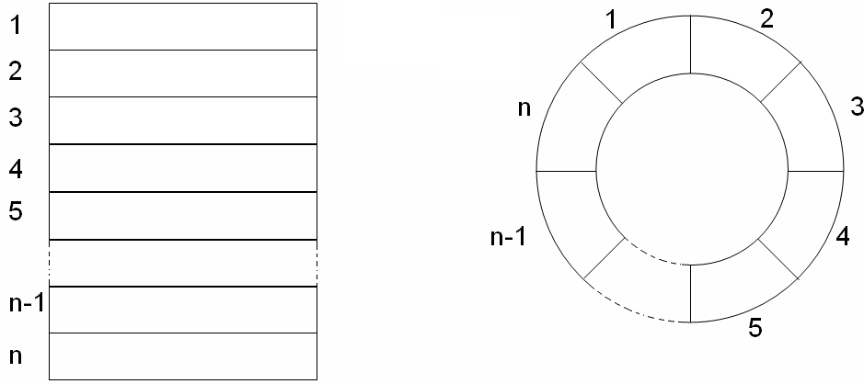
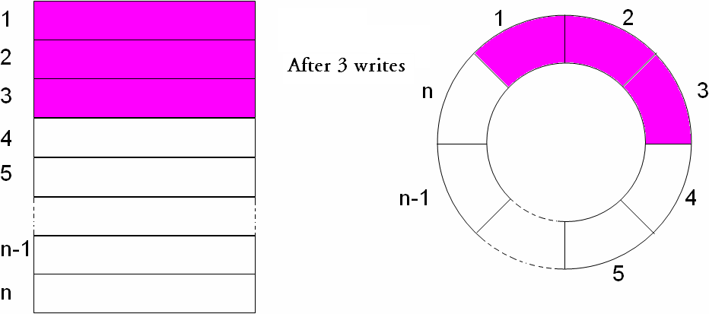
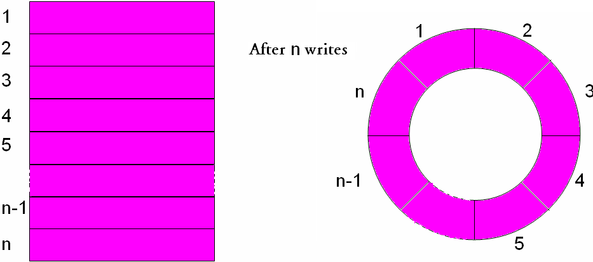
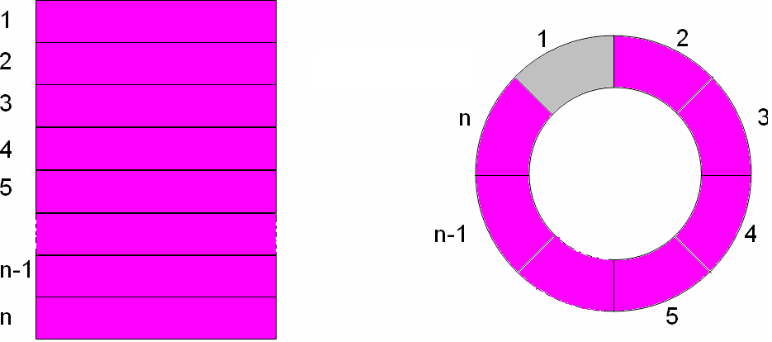
MIFARE DESFire EV1 cyclic and linear record file
Linear record file
Cyclic record file
at n+1 Writes
Record File full
at n+2 writes
Error
Cyclic record file stores latest n-1 records
M305_MIFARE DESFire Training - MIFARE DESFire EV1 Architecture _AIv13.01.ppt

Slide 17
MIFARE DESFire EV1 back-up management for record file
Record file
Record #1
Current record
Record #2
Write
into next empty record
Record #3
Record #3
Write record
Record #n-1
Record #n
Commit Transaction validates new record #
Record #1
Current record
Record #2
Record #3
Record #n-1
Record #n
M305_MIFARE DESFire Training - MIFARE DESFire EV1 Architecture _AIv13.01.ppt

Slide 18
MIFARE DESFire EV1 back-up management
Transaction oriented approach
On application level, multiple write commands can be issued in multiple file.
Completed transaction has to be validated by a CommitTransaction command.
If not validated, a full rollback of all writes happens.
Either ALL writes are done or NO writes are done.
→ Application data is always consistent
M305_MIFARE DESFire Training - MIFARE DESFire EV1 Architecture _AIv13.01.ppt

Slide 19
MIFARE DESFire EV1 application example
Up to 32 different files per application
Application 0x 00 00 02
File 0x03
File
0x07
Appl
0x 00 00 02
Appl
0x 00 00 03
File
0x0C
File 0x04
Appl
0x 00 00 01
M305_MIFARE DESFire Training - MIFARE DESFire EV1 Architecture _AIv13.01.ppt

Slide 20
MIFARE DESFire EV1 application example con.
Application # 0x 00 00 02 contains 4 Files:
File 0x03:
File 0x07:
Value file
lower limit: -10
upper limit: +2000
MACed data
Application 0x 00 00 02
File 0x03
File
0x07
Back-up data file
File size: 30 bytes
3DES encrypted
communication
File
0x0C
File 0x04
File 0x0C:
Standard data file
File size: 30 bytes
Plain communication
File 0x04:
Cyclic record file
Record size: 10 bytes
# of records: 21
MACed communication
M305_MIFARE DESFire Training - MIFARE DESFire EV1 Architecture _AIv13.01.ppt

Slide 21
MIFARE DESFire EV1 application example con..
KEY 0
Application # 0x 00 00 02 contains 4 files and 5 keys:
KEY 1
KEY 2
KEY 3
KEY 4
free
never
Application 0x 00 00 02
File 0x03
File
0x07
File
0x0C
File 0x04
R W R&W C
R W R&W C
R W R&W C
R W R&W C
File 0x0C:
File 0x03:
File 0x04:
File 0x07:
Standard
data file
Value file
Cyclic
record file
Back-up
data file
M305_MIFARE DESFire Training - MIFARE DESFire EV1 Architecture _AIv13.01.ppt

Slide 22
Thank you very much.
We appreciate your feedback.
Abu Ismail
Senior Engineer, Customer Application Support
Business Unit Identification
NXP Semiconductors Germany GmbH
Stresemannallee 101, 22529 Hamburg, Germany
Tel: +49(0)40 5613 5070, Mob:+49(0)15115210535, Fax:+49(0)40561365070
abu.ismail@nxp.com, http://www.nxp.com, http://www.mifare.net
M305_MIFARE DESFire Training - MIFARE DESFire EV1 Architecture _AIv13.01.ppt

